Slide 1


Slide 2
Requirements
at least two graphs containing exploration of the dataset
a statement of your question (or questions!) and how you arrived there
the explanation of at least two new columns you created and how you did it
the comparison between two classification approaches, including a qualitative discussion of simplicity, time to run the model, and accuracy, precision, and/or recall
the comparison between two regression approaches, including a qualitative discussion of simplicity, time to run the model, and accuracy, precision, and/or recall
an overall conclusion, with a preliminary answer to your initial question(s), next steps, and what other data you would like to have in order to better answer your question(s)

Slide 3
Outline
Data -> Questions -> Overview of Models - > Results - > Conclusions

Slide 4
Data Overview
Data from OkCupid
Useful as a self-reported census data
OkCupid, also has many missing Income fields. Can we use other features in the data to generate a regression model to predict it? Perspective advertisers on the site would surely be interested in income levels of its user base.
Outside can we use certain traits about an id
Notes:
at least two graphs containing exploration of the dataset

Slide 5
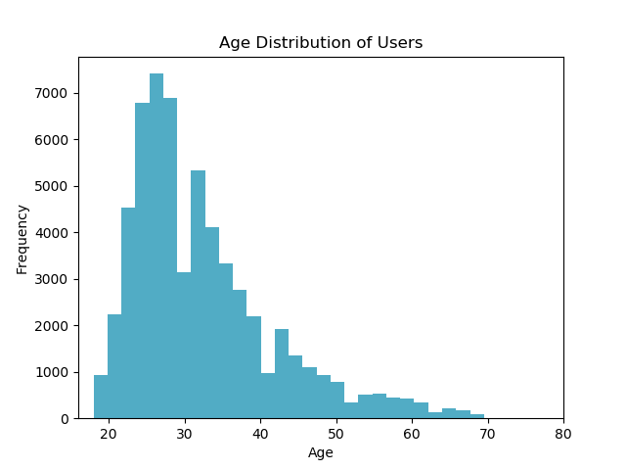
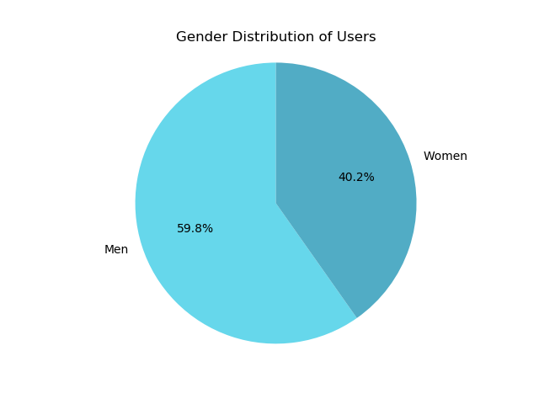
Inspecting Basic Demographics User Data
Two graphs - at least two graphs containing exploration of the dataset

Slide 6
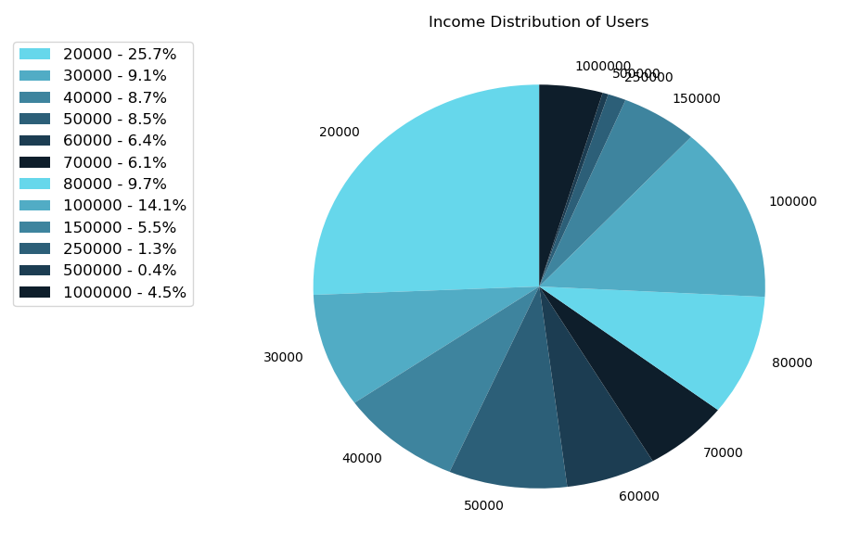
Inspecting User Income Data
The provided data set includes data for 59,946 users.
Unfortunately, inspection revealed that 80.8% of users provided no income data.
Income distribution for the remaining 11,504 users in the data set is presented along with a Five Number Summary.
Minimum Value | $20k
First Quartile | $20k
Median | $50k
Third Quartile | $100k
Maximum Value | $1,000k
Interesting Observation: 6.2% of users report an income in excess of $200k
Notes:
df = df[df.income != -1] # drop users with no reported income
print(df.income.describe())
count 11504.000000
mean 104394.993046
std 201433.528307
min 20000.000000
25% 20000.000000
50% 50000.000000
75% 100000.000000
max 1000000.000000

Slide 7
Notes:
Data, linear retlationship in data

Slide 8
Questions to Provide Actionable Insights
Perspective advertisers are interested in income levels of OkCupid’s user base. That said, the provided data set has many entries with missing Income information. Can we use other features such as education, age, and field of employment to generate regression models to accurately predict a user’s income and populate the omitted data?
There is also an opportunity to take OkCupid data and gain insights that may appeal more broadly to advertisers. For example, advertisers have browser history metadata that allows them to deduce a user’s field of employment and whether or not they have dietary preferences like vegetarianism. Using OkCupid data, can we generate a classification models to predict a user’s gender so that advertisers may augment their own data sets and develop even more targeted ads?
Notes:
a statement of your question (or questions!) and how you arrived there

Slide 9
Regression Model to Predict Income
Can we use level of education, field of work, and age (an approximation of experience) to accurately predict someone’s income level independent of factors that should not apply anyways such as a person’s gender, sexual orientation, and ethnicity.
Later create model with added factors?
Location however can be expected to be an influencing factor. To account for this, our first pass will limit data to users living in California. (% of provided profiles live in California which allows us to account to some degree for location while also preserving most of the data set)

Slide 10
Classification Model to Predict Gender
Recently there have been a nationwide initiatives to encourage more women to venture into science, technology, engineering, and mathematics (STEM) fields based on the data that women generally steer clear these career fields and instead opt for professions in other domains like health and teaching.
On an unrelated note, eschewing meat-eating may not be perceived as a masculine trait. Women are also generally perceived to have a more compassionate view of animals than men. For these reasons among others, women may be more inclined than men to adopt a vegan or vegetarian diet.
Do either of these assumptions hold true? Can we create a classification model to predict a person’s gender based on their field of work and diet preferences?

Slide 11
Augmenting Data
Education_code
income_z: column of Z-Score Normalized income
Z-Score normalization was chosen because while most reported incomes were below $200k, a small percentage of users reported income as high as $1M. A simple Min-Max normalization process would have removed much of the fidelity for the majority of our data set.
education_mapping = {"dropped out of space camp ": 0, "working on space camp": 0, "space camp": 0, "graduated from space camp": 0, "dropped out of high school": 1, "working on high school": 2, "high school": 2, "graduated from high school": 3, "dropped out of two-year college": 3, "dropped out of college/university": 3, "working on two-year college": 4, "two-year college": 4, "working on college/university": 5, "college/university": 5, "graduated from two-year college": 6, "graduated from college/university": 7, "dropped out of masters program": 7, "dropped out of law school": 7, "dropped out of med school": 7, "working on masters program": 8, "working on med school": 8, "med school": 8, "working on law school": 8, "law school": 8, "masters program": 8, "graduated from masters program": 9, "dropped out of ph.d program": 9, "working on ph.d program": 10, "ph.d program": 10, "graduated from law school": 11, "graduated from ph.d program": 11, "graduated from med school": 11} df['education_code'] = df['education'].map(education_mapping)
df = df[df.income != -1] df['income_z'] = (df['income'] - df['income'].mean()) / df['income'].std(ddof=0)
Notes:
the explanation of at least two new columns you created and how you did it
Education Code – strings to linearized variables
Income already in a linear set but the scale is quite different than other features, so normalize it and create a new column to hold the normalized value

Slide 12
education_mapping = {"dropped out of space camp ": 0, "working on space camp": 0, "space camp": 0, "graduated from space camp": 0, "dropped out of high school": 1, "working on high school": 2, "high school": 2, "graduated from high school": 3, "dropped out of two-year college": 3, "dropped out of college/university": 3, "working on two-year college": 4, "two-year college": 4, "working on college/university": 5, "college/university": 5, "graduated from two-year college": 6, "graduated from college/university": 7, "dropped out of masters program": 7, "dropped out of law school": 7, "dropped out of med school": 7, "working on masters program": 8, "working on med school": 8, "med school": 8, "working on law school": 8, "law school": 8, "masters program": 8, "graduated from masters program": 9, "dropped out of ph.d program": 9, "working on ph.d program": 10, "ph.d program": 10, "graduated from law school": 11, "graduated from ph.d program": 11, "graduated from med school": 11} df['education_code'] = df['education'].map(education_mapping)

Slide 13
Age – normalize - linear
Diet – nonlinear groups
Education – linear grouping - normalize
Ethnicity – nonlinear groups
Income - normalize linear – has outliers
Job – nonlinear groups
Location -
Orientation – nonlinear groups
Sex – nolinear groups

Slide 14
Classification Models
K Nearest Neighbors
Support Vector Machines
Logistic Regression
Regression Models
K Neighbors Regression
Still struggles with some of the linearization but can reasonably handle it?
Multiple Linear Regression
Data must be linearized

Slide 15
Regression Models
Notes:
the comparison between two regression approaches, including a qualitative discussion of simplicity, time to run the model, and accuracy, precision, and/or recall

Slide 16
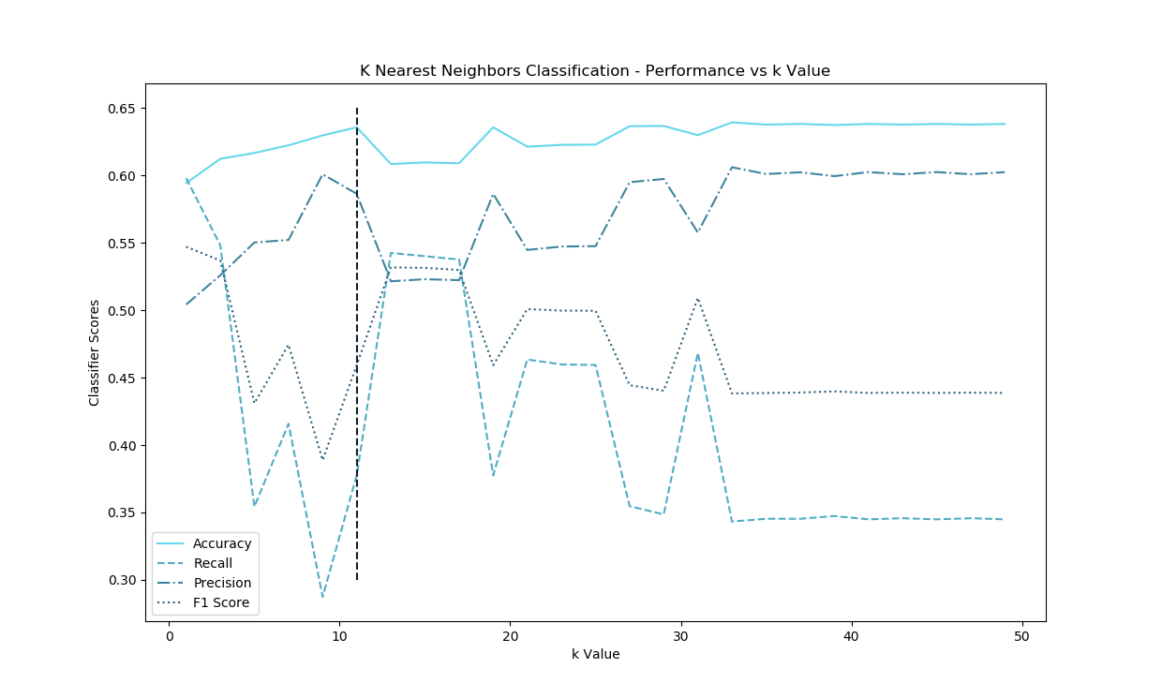
K Nearest Neighbors Classifier Setup
For our classification model we are seeking to identify the sex of a user based on career field and dietary preferences.
Since both sexes appear with roughly equal measure, the model’s accuracy score should be the dominant driver for choosing k.
That stated, there is no reason to choose k such that the secondary metrics of precision and recall suffer.
With these considerations, trials reveal k=11 as the optimal number of nearest neighbors for the classifier.
Optimal k=11
Notes:
the comparison between two classification approaches, including a qualitative discussion of simplicity, time to run the model, and accuracy, precision, and/or recall
SVM takes longer to run

Slide 17
For approximately 28,000 data rows, the Support Vector Machine requires more than 10 seconds to perform classification model initialization, training, and scoring.
The K Nearest Neighbors Classifier performs the same task in less that 0.5 seconds (a 20x+ improvement).
Saving processor time by using the K Nearest Neighbor Classifier also as performance is similar with both having accuracy scores 0.62

Slide 18
Machine Learning Model Conclusions
Linear Regression Models
Classification Models performed better than Regression Models but have room for improvement
Notes:
an overall conclusion, with a preliminary answer to your initial question(s), next steps, and what other data you would like to have in order to better answer your question(s)

Slide 19
Enabling More Accurate ML Models
Augmenting at least two of the primary data features used with new information would enable the development of more accurate machine learning models.
The Job Field feature as it stands right now is not sufficient enough to enable regression models to predict income. For example, the “Medicine / Health” field could conceivably include users with diverse positions ranging from Pharmacy Technician to Neurosurgeon. Thus it is also safe to assume a wide variance in reported incomes, even within the same field. Augmenting the Job Field data with Profession or Job Title is recommended.
Similar arguments can be made to augment Education with details on the field of study. For example, a user with a MS. in Electrical Engineering may in general earn more than a user with a M.A. in Literature but with current data, regression models treat both of these users as the same as they have an equivalent education level. Augmenting the Education data with Field of Study or Degree Title is recommended.
Notes:
an overall conclusion, with a preliminary answer to your initial question(s), next steps, and what other data you would like to have in order to better answer your question(s)

Slide 20
Next Steps
Augment Job Field and Education data as described
Employing Naïve Bayes classification methods like CountVectorizers on profession titles and field of study inputs could provides a finer resolution data set that allows us to form subclasses and provide feature data that allows a regression model to more accurately predict a user’s income when it is not reported.

